Slide 1
Please click on Power Point Presentation.
Files Related to this Article
Prof. Muzaffer Değertekin

Slide 2
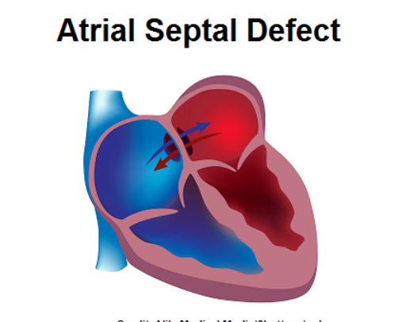
ATRIAL SEPTAL DEFECT-ASD CLOSURE

Slide 3
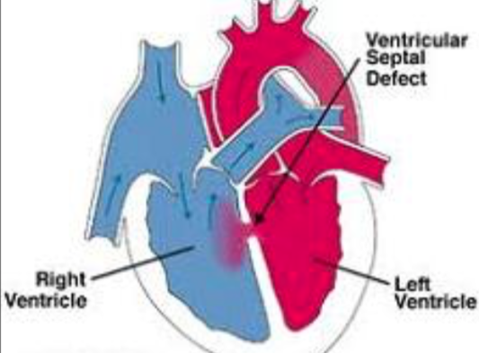
VENTRICULAR SEPTAL DEFECT-VSD CLOSURE

Slide 4
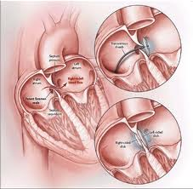
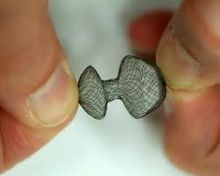
Defect Closing Devices

Slide 5
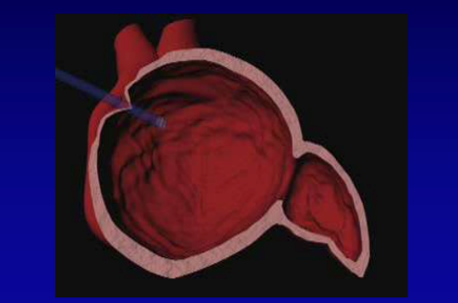
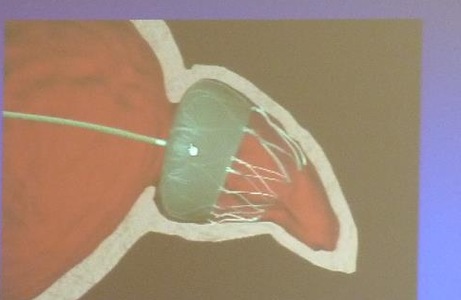
Left Atrial Appendage Closure for Stroke Prevention

Slide 6
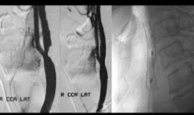
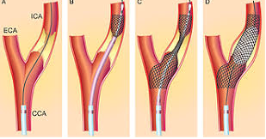
Karotis Artere Stenting

Slide 7
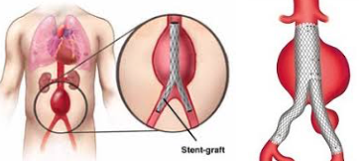
Percutaneous Repair of Abdominal Aortic Aneurysm

Slide 8
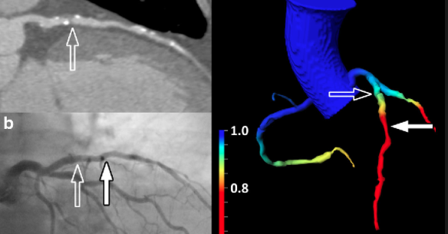
New Angiography Methods Indicating the Severity of Cardiovascular Stenosis

Slide 9
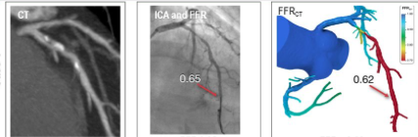
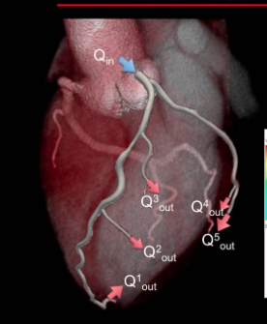
New Angiography Methods Indicating the Severity of Cardiovascular Stenosis
Kritik darlık varsa kırmızı oluyor
ve stent takılması gerekli

Slide 10
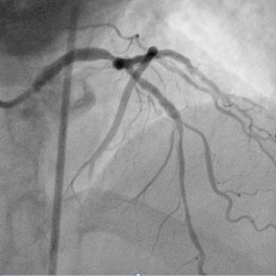
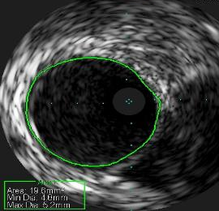
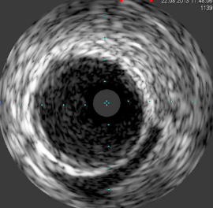
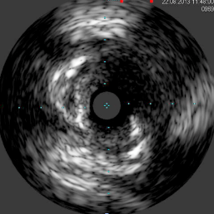
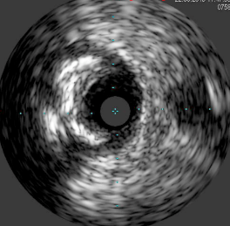
Ultrasound Monitoring of the Vasculature
SP

Slide 11

